Slide 1


https://reurl.cc/Y6vpAX
早
https://github.com/chiustin/NTU_Artifical_Intelligence_in_Chemistry_with_Keras

Slide 2

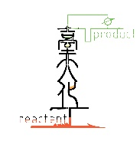
Deep Learning (II)
楊延齡
d00524018@ntu.edu.tw
09/09/2020

Slide 3
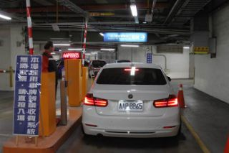
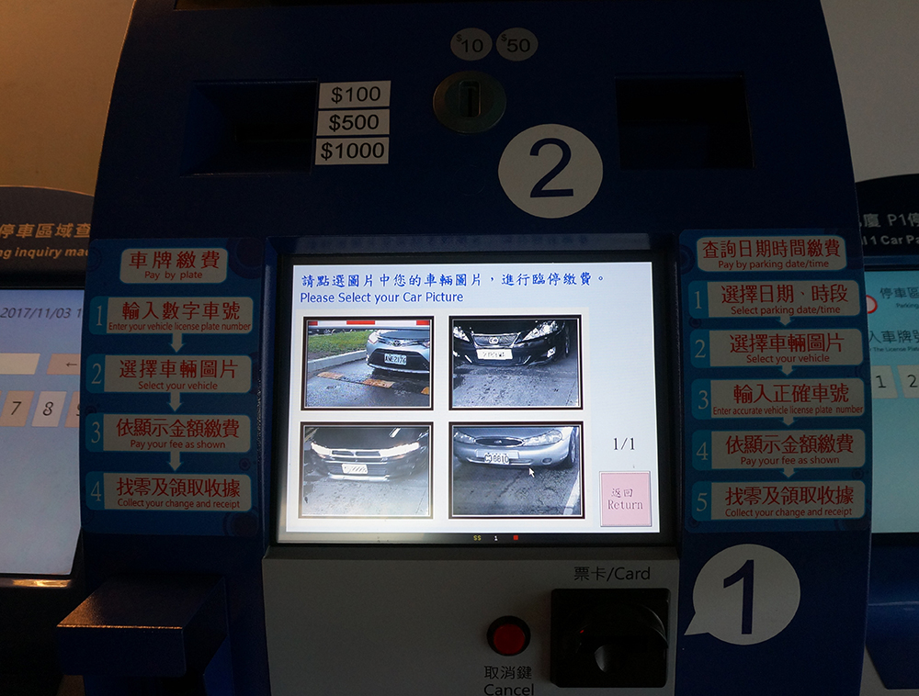
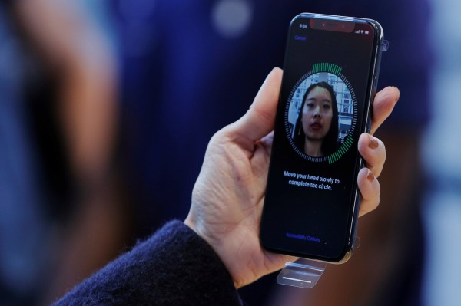
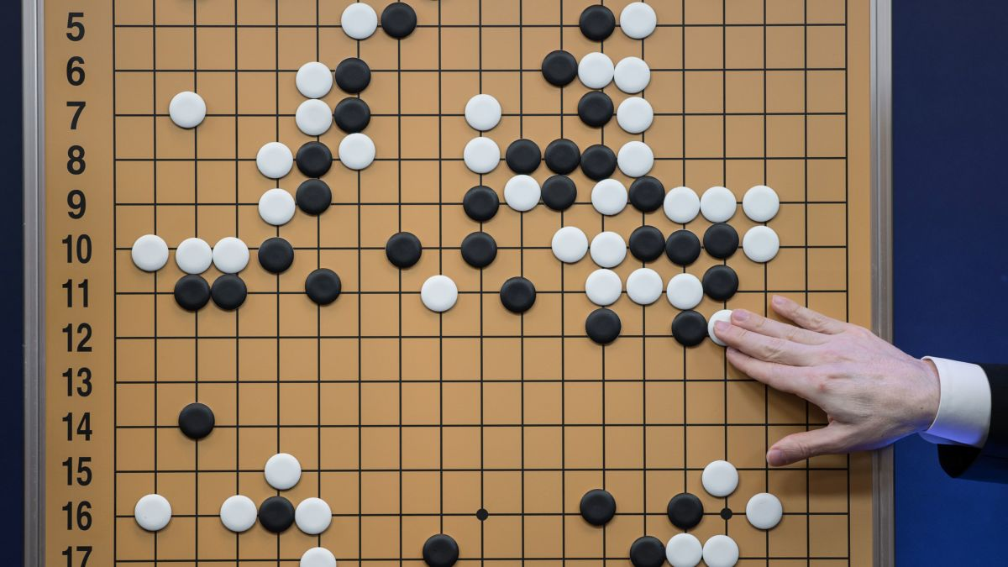
Image Recognition
Some applications of CNN:
Recognition of License Plates
Face ID
Play Go

Slide 4
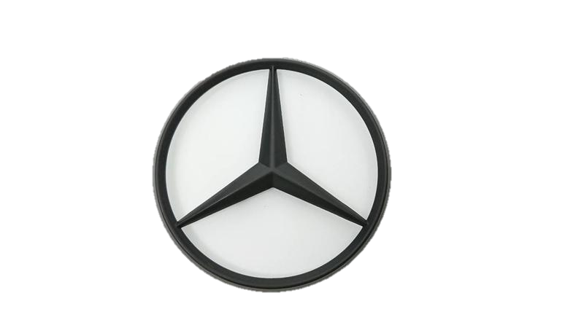
Image Recognition
Human
50 | 50 | 50 | 0 | 50 | 50 | 50
50 | 50 | 50 | 0 | 50 | 50 | 50
50 | 50 | 50 | 0 | 50 | 50 | 50
50 | 50 | 0 | 50 | 0 | 50 | 50
50 | 0 | 50 | 50 | 50 | 0 | 50
0 | 50 | 50 | 50 | 50 | 50 | 0
Grayscale image:
Using one value to represent the intensity of light
for each pixel (0~255)
Robot
value:0
value:50
Notes:
https://bangqu.com/I21XG7.html

Slide 5

Neural Network
i₁
j₁
50 | 50 | 50 | 0 | 50 | 50 | 50
50 | 50 | 50 | 0 | 50 | 50 | 50
50 | 50 | 50 | 0 | 50 | 50 | 50
50 | 50 | 0 | 50 | 0 | 50 | 50
50 | 0 | 50 | 50 | 50 | 0 | 50
0 | 50 | 50 | 50 | 50 | 50 | 0
k₁
???
i_{m}
$$\text{j}\text{m}$$

Slide 6
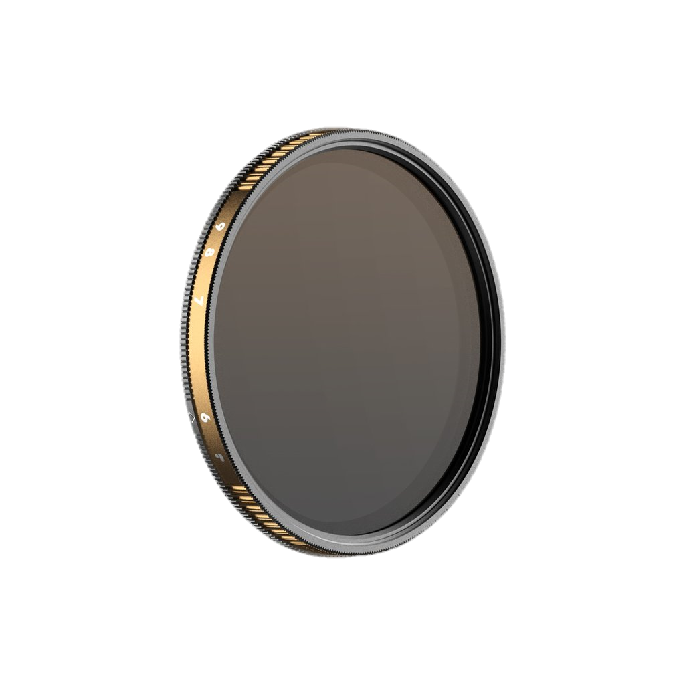
Convolution
Convolution
Filter (kernel)
50 | 50 | 50 | 0 | 50 | 50 | 50
50 | 50 | 50 | 0 | 50 | 50 | 50
50 | 50 | 50 | 0 | 50 | 50 | 50
50 | 50 | 0 | 50 | 0 | 50 | 50
50 | 0 | 50 | 50 | 50 | 0 | 50
0 | 50 | 50 | 50 | 50 | 50 | 0
-60
-0.1 | -0.2 | -0.1
-0.1 | -0.2 | -0.1
-0.1 | -0.2 | -0.1
50*-0.1+50*-0.2+50*-0.1+
50*-0.1+50*-0.2+50*-0.1+
50*-0.1+50*-0.2+50*-0.1
value:0
value:50

Slide 7
Filter
Convolution
Filter (kernel)
50 | 50 | 50 | 0 | 50 | 50 | 50
50 | 50 | 50 | 0 | 50 | 50 | 50
50 | 50 | 50 | 0 | 50 | 50 | 50
50 | 50 | 0 | 50 | 0 | 50 | 50
50 | 0 | 50 | 50 | 50 | 0 | 50
0 | 50 | 50 | 50 | 50 | 50 | 0
-60 | -45
-0.1 | -0.2 | -0.1
-0.1 | -0.2 | -0.1
-0.1 | -0.2 | -0.1
50*-0.1+50*-0.2+0*-0.1+
50*-0.1+50*-0.2+0*-0.1+
50*-0.1+50*-0.2+0*-0.1
value:0
value:50

Slide 8
Filter
Convolution
Filter (kernel)
50 | 50 | 50 | 0 | 50 | 50 | 50
50 | 50 | 50 | 0 | 50 | 50 | 50
50 | 50 | 50 | 0 | 50 | 50 | 50
50 | 50 | 0 | 50 | 0 | 50 | 50
50 | 0 | 50 | 50 | 50 | 0 | 50
0 | 50 | 50 | 50 | 50 | 50 | 0
-60 | -45 | -30
-0.1 | -0.2 | -0.1
-0.1 | -0.2 | -0.1
-0.1 | -0.2 | -0.1
50*-0.1+0*-0.2+50*-0.1+
50*-0.1+0*-0.2+50*-0.1+
50*-0.1+0*-0.2+50*-0.1
value:0
value:50

Slide 9
Filter
Filter (kernel)
50 | 50 | 50 | 0 | 50 | 50 | 50
50 | 50 | 50 | 0 | 50 | 50 | 50
50 | 50 | 50 | 0 | 50 | 50 | 50
50 | 50 | 0 | 50 | 0 | 50 | 50
50 | 0 | 50 | 50 | 50 | 0 | 50
0 | 50 | 50 | 50 | 50 | 50 | 0
-60 | -45 | -30 | -45 | -60
-55 | -40 | -30 | -40 | -55
-45 | -40 | -40 | -40 | -45
-40 | -45 | -50 | -45 | -40
-0.1 | -0.2 | -0.1
-0.1 | -0.2 | -0.1
-0.1 | -0.2 | -0.1
value:0
Feature map
value:50

Slide 10
Filter
Filter (kernel)
50 | 50 | 50 | 0 | 50 | 50 | 50
50 | 50 | 50 | 0 | 50 | 50 | 50
50 | 50 | 50 | 0 | 50 | 50 | 50
50 | 50 | 0 | 50 | 0 | 50 | 50
50 | 0 | 50 | 50 | 50 | 0 | 50
0 | 50 | 50 | 50 | 50 | 50 | 0
-60 | -40 | -40 | -40 | -60
-55 | -40 | -30 | -45 | -50
-50 | -30 | -45 | -40 | -50
-30 | -50 | -45 | -50 | -40
-0.1 | -0.1 | -0.2
-0.1 | -0.2 | -0.1
-0.2 | -0.1 | -0.1
value:0
value:50

Slide 11
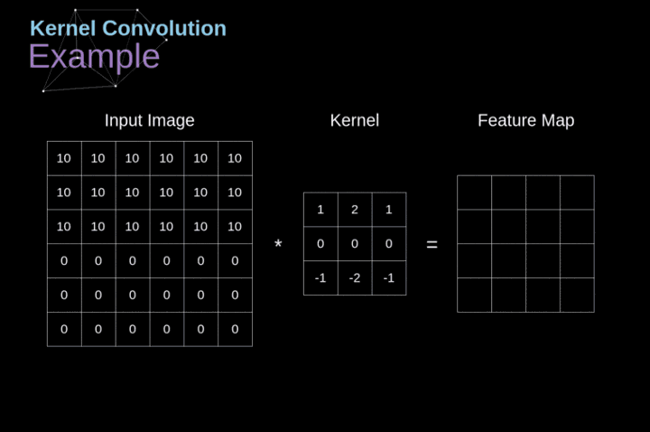
Convolution

Slide 12
Filter

Slide 13
Max Pooling
Max
-60 | -45 | -30 | -45 | -60
-55 | -40 | -30 | -40 | -55
-45 | -40 | -40 | -40 | -45
-40 | -45 | -50 | -45 | -40
-40
-0.1 | -0.2 | -0.1
-0.1 | -0.2 | -0.1
-0.1 | -0.2 | -0.1

Slide 14
Max Pooling
Max
-60 | -45 | -30 | -45 | -60
-55 | -40 | -30 | -40 | -55
-45 | -40 | -40 | -40 | -45
-40 | -45 | -50 | -45 | -40
-40 | -30
-0.1 | -0.2 | -0.1
-0.1 | -0.2 | -0.1
-0.1 | -0.2 | -0.1

Slide 15
Max Pooling
-60 | -45 | -30 | -45 | -60
-55 | -40 | -30 | -40 | -55
-45 | -40 | -40 | -40 | -45
-40 | -45 | -50 | -45 | -40
-40 | -30 | -30 | -40
-40 | -30 | -30 | -40
-40 | -40 | -40 | -40
-0.1 | -0.2 | -0.1
-0.1 | -0.2 | -0.1
-0.1 | -0.2 | -0.1

Slide 16
Max Pooling
-60 | -40 | -40 | -40 | -60
-55 | -40 | -30 | -45 | -50
-50 | -30 | -45 | -40 | -50
-30 | -50 | -45 | -50 | -40
-40 | -30 | -30 | -40
-30 | -30 | -30 | -40
-30 | -30 | -40 | -40
-0.1 | -0.1 | -0.2
-0.1 | -0.2 | -0.1
-0.2 | -0.1 | -0.1

Slide 17
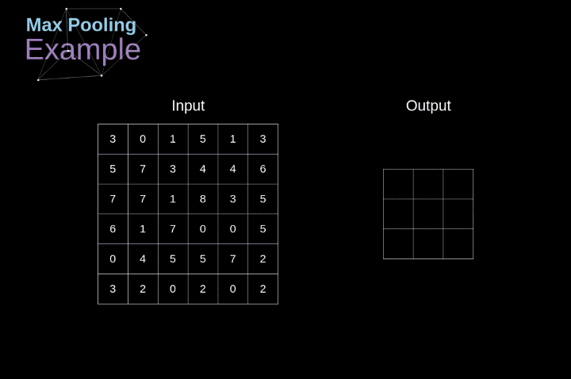
Max Pooling
Notes:
https://bangqu.com/I21XG7.html

Slide 18
Convolution and Max Pooling
-0.1 | -0.2 | -0.1
-0.1 | -0.2 | -0.1
-0.1 | -0.2 | -0.1
-60 | -45 | -30 | -45 | -60
-55 | -40 | -30 | -40 | -55
-45 | -40 | -40 | -40 | -45
-40 | -45 | -50 | -45 | -40
-40 | -30 | -30 | -40
-40 | -30 | -30 | -40
-40 | -40 | -40 | -40
-60 | -40 | -40 | -40 | -60
-55 | -40 | -30 | -45 | -50
-50 | -30 | -45 | -40 | -50
-30 | -50 | -45 | -50 | -40
-40 | -30 | -30 | -40
-30 | -30 | -30 | -40
-30 | -30 | -40 | -40
-0.1 | -0.1 | -0.2
-0.1 | -0.2 | -0.1
-0.2 | -0.1 | -0.1

Slide 19
Stride
-1
-1
-1
stride=2
1
1
1
Filter 1
0
0
0
0
0
1
1
-1
-1
-1
x-1
x-1
x-1
1
1
1
0
1
0
x1
x1
x1
0
0
0
1
0
0
x-1
x-1
x-1
3
1
0
0
0
0
1
0
0
1
1
1
0
0
0
0
0
0
0
0
6 X 6 image

Slide 20
CNN-Convolution
-1
-1
-1
stride=2
1
1
1
Filter 1
0
0
0
0
0
1
1
-1
-1
-1
1
1
1
0
1
0
0
0
0
1
0
0
x-1
x-1
x-1
3
1
0
0
0
0
1
0
x1
x1
x1
-2
-2
0
1
1
1
0
0
x-1
x-1
x-1
0
0
0
0
0
0
Increasing stride will decrease the amount of information, but speed up the computation
6 X 6 image

Slide 21
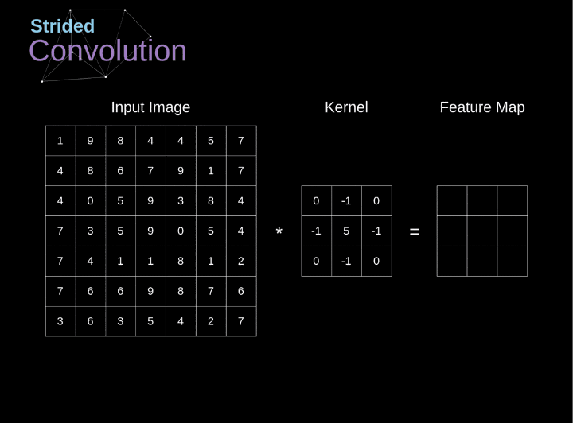
Convolution
= 2

Slide 22
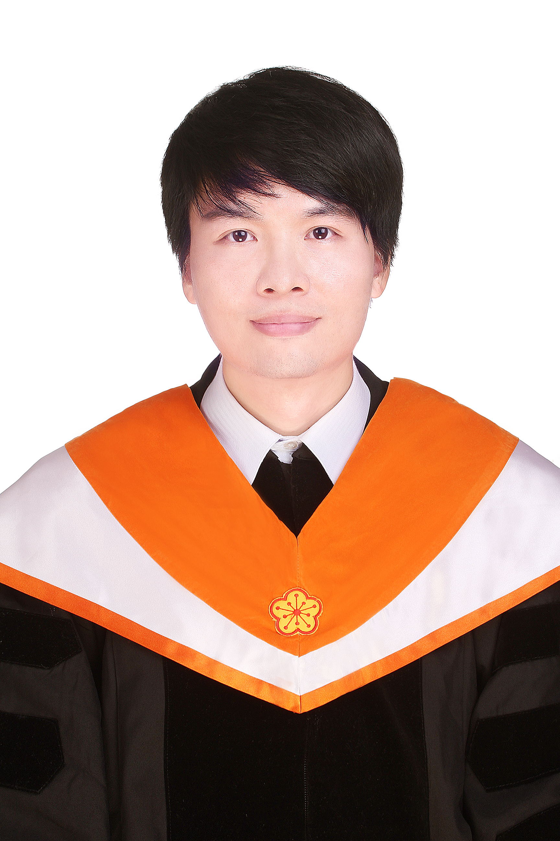
CNN-Convolution
RGB
3 colors (3 channels)
3x3 filter
Height: 254 units(pixels)
Can a filter generate 3 feature maps? NO
256 x 256 x 3
Width: 254 units(pixels)
254 x 254 x 3 RGB Image

Slide 23

Convolution Operation on a Input matrix with a 3x3x3 Kernel
Each filter can generate only one feature map

Slide 24
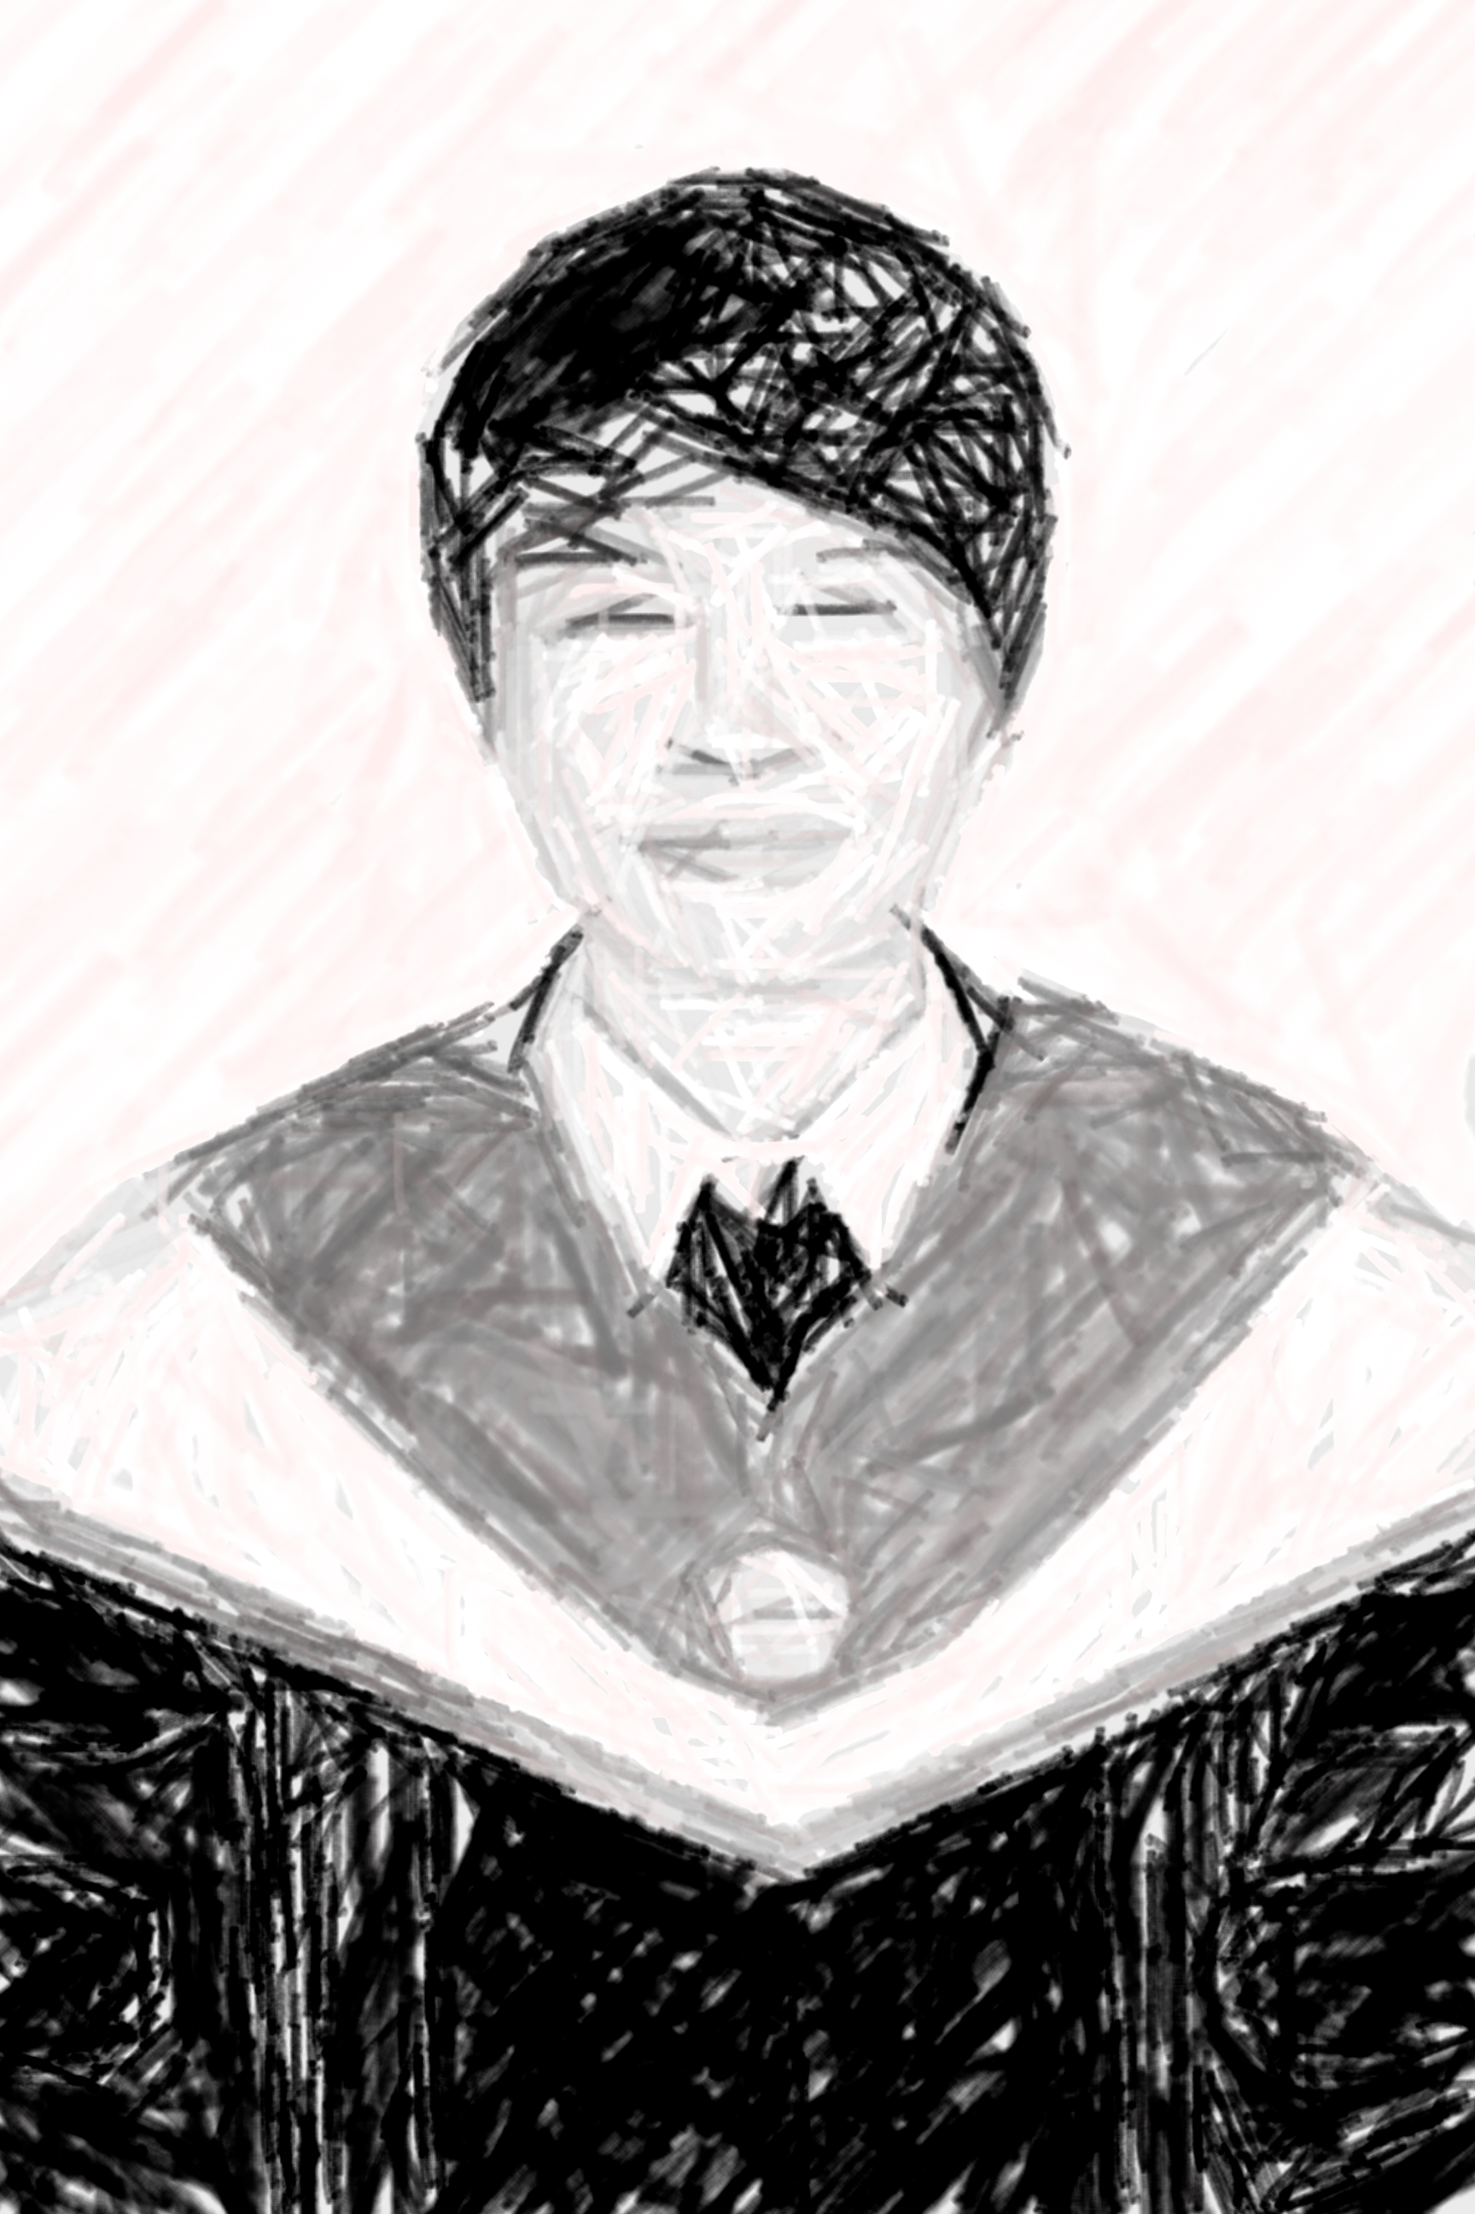
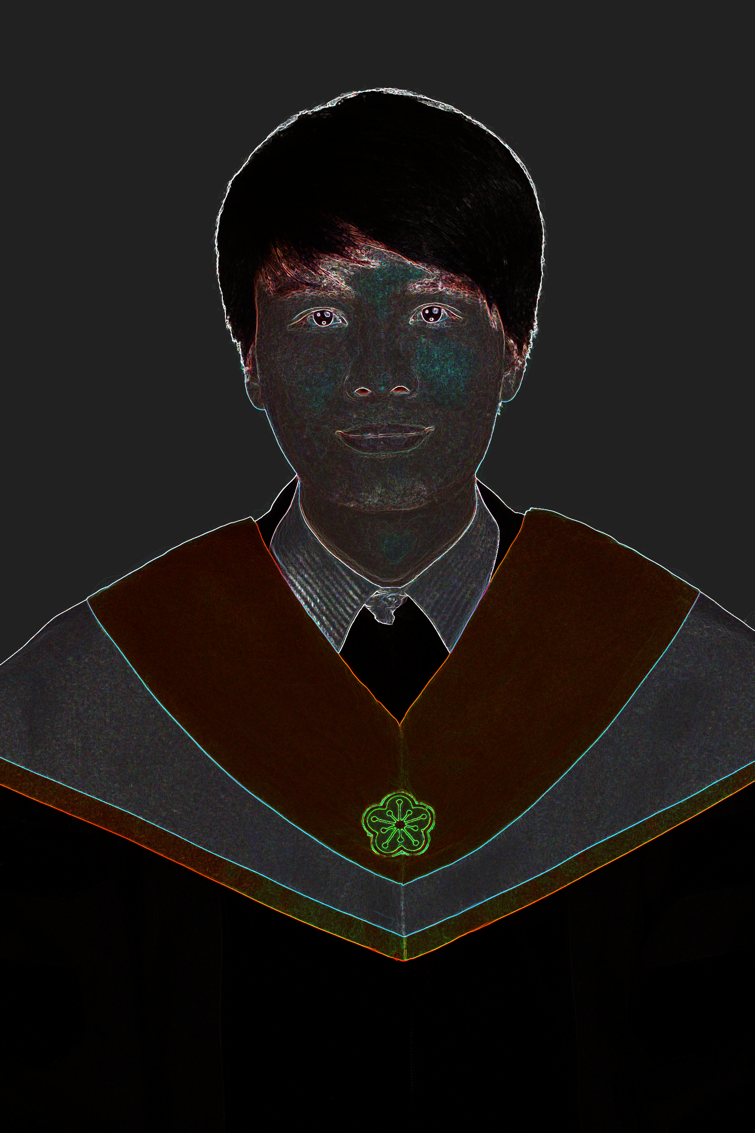
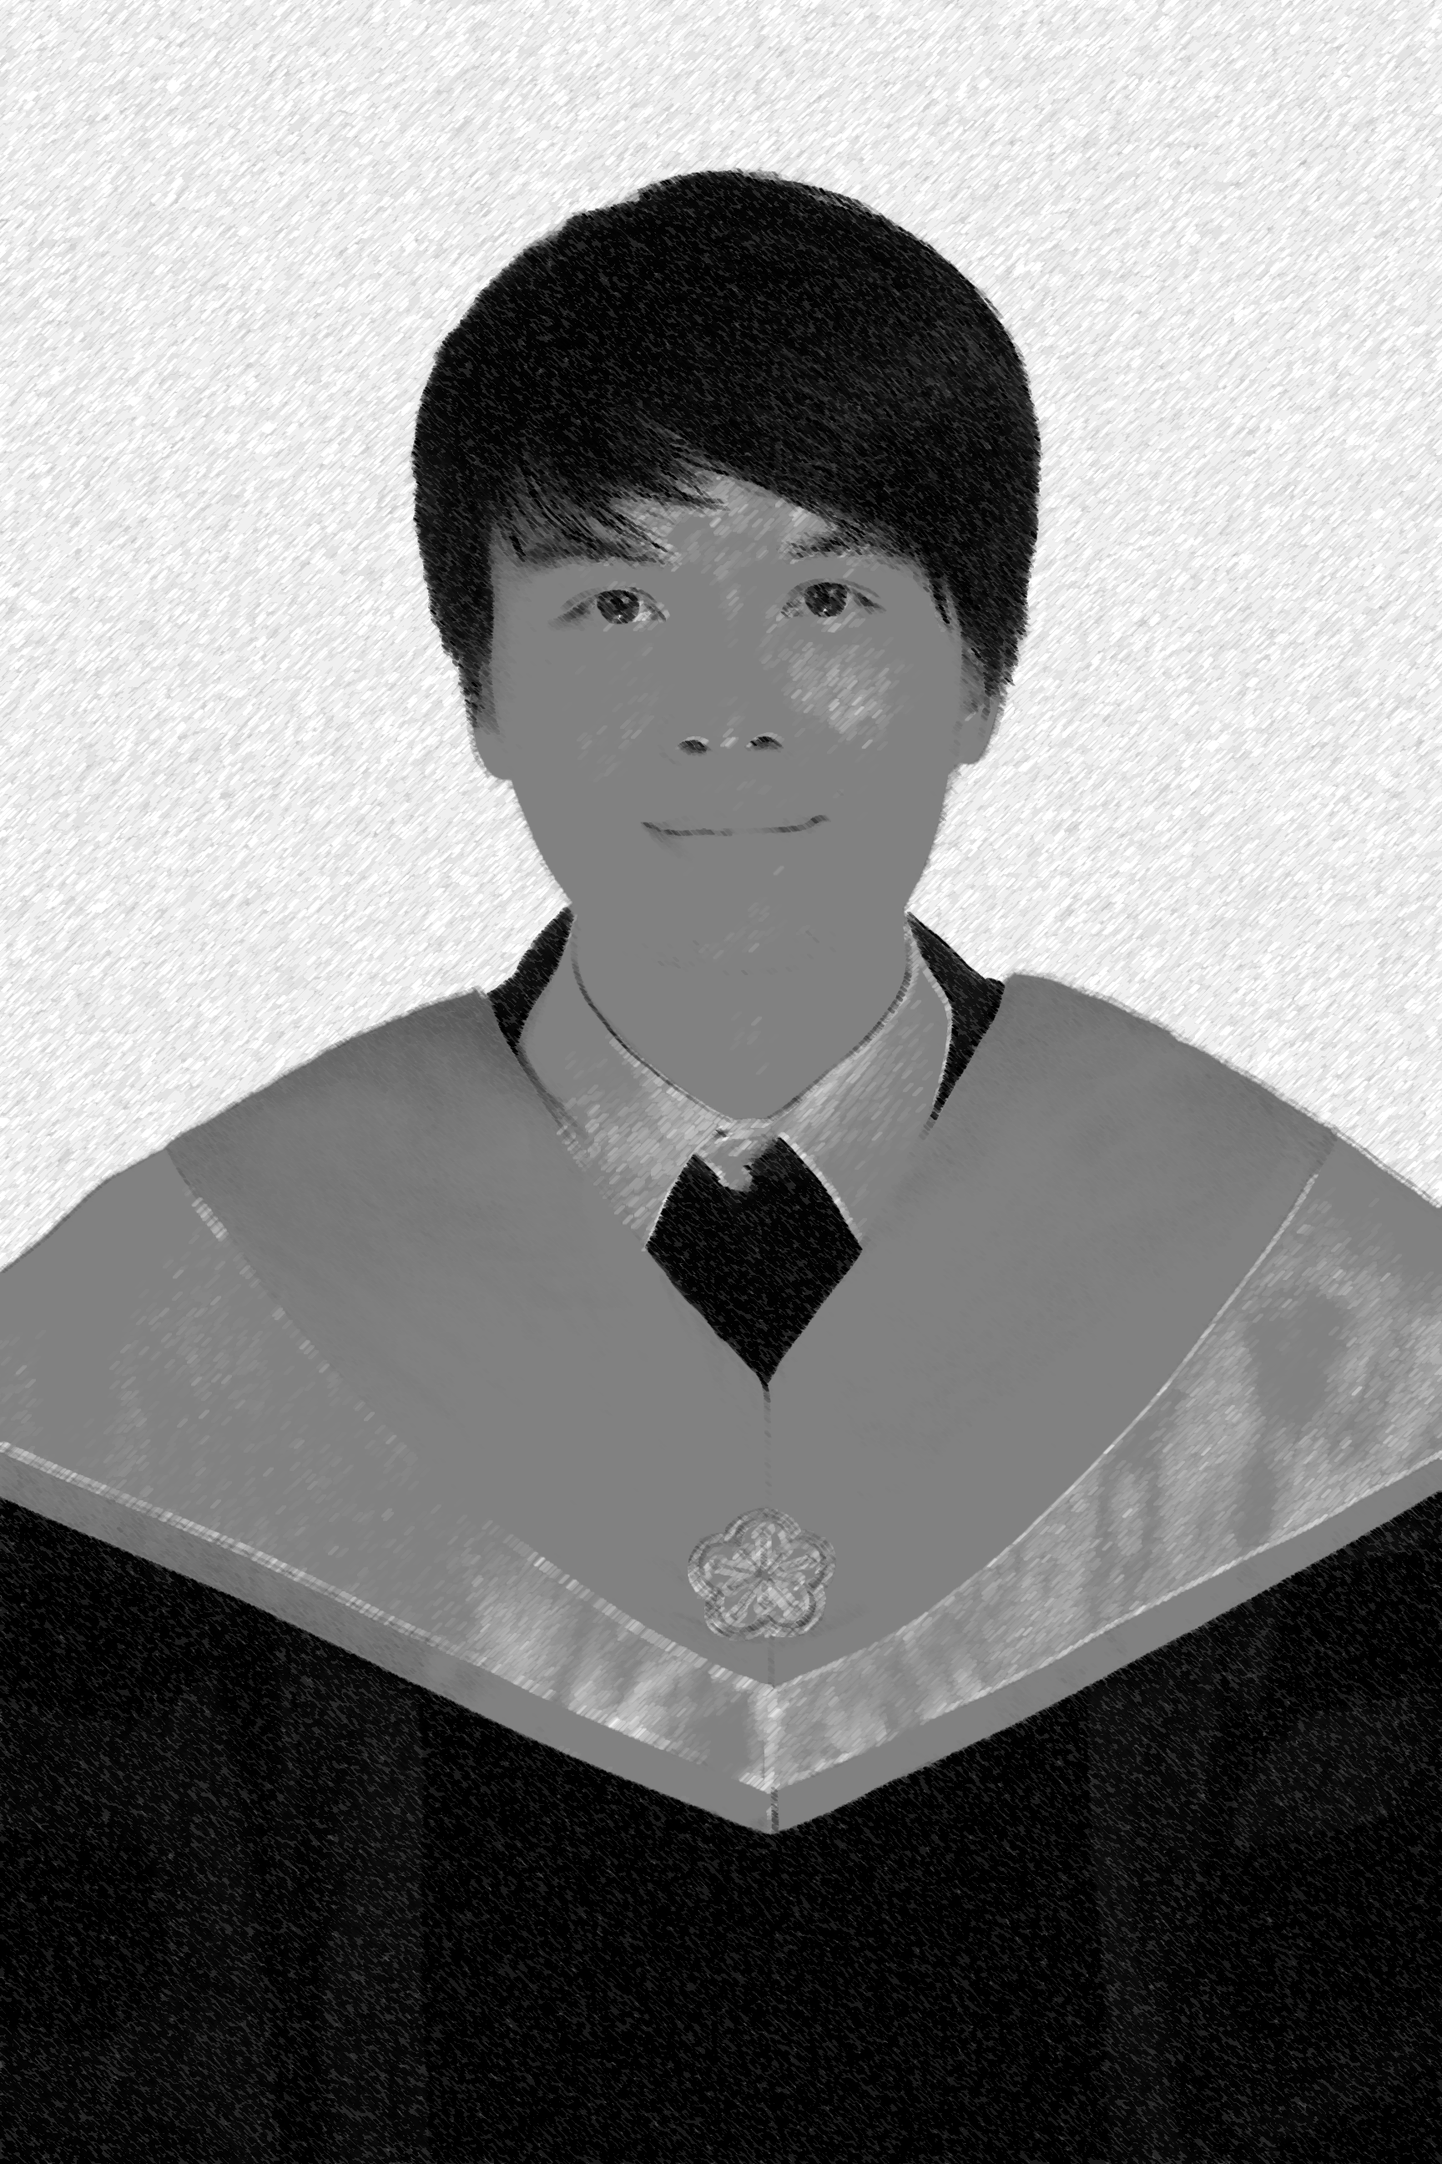
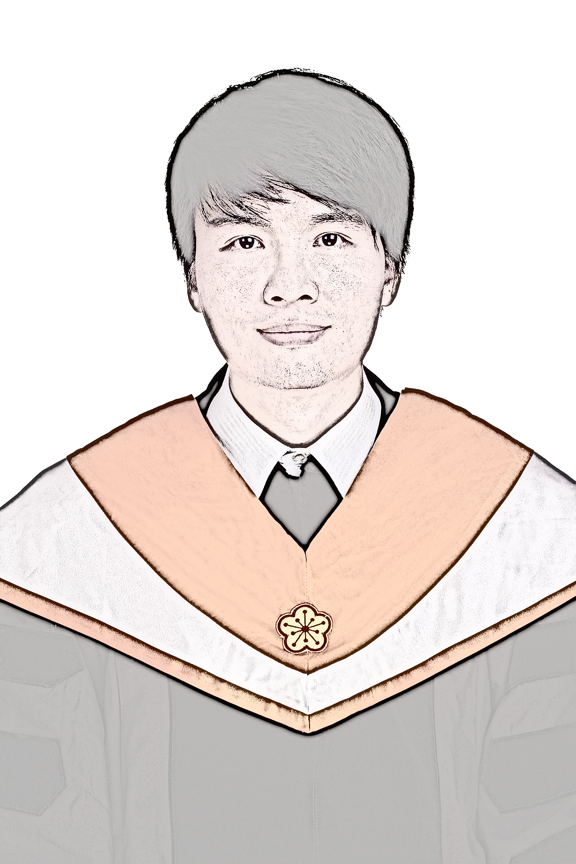
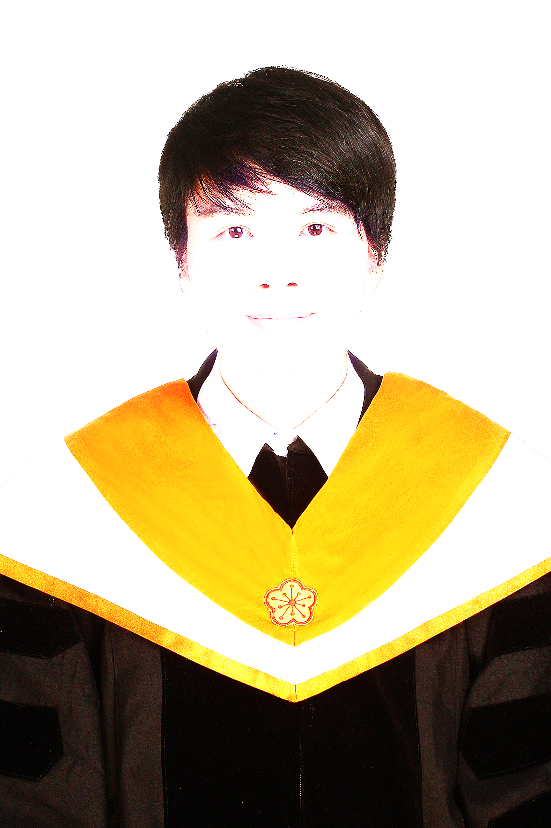
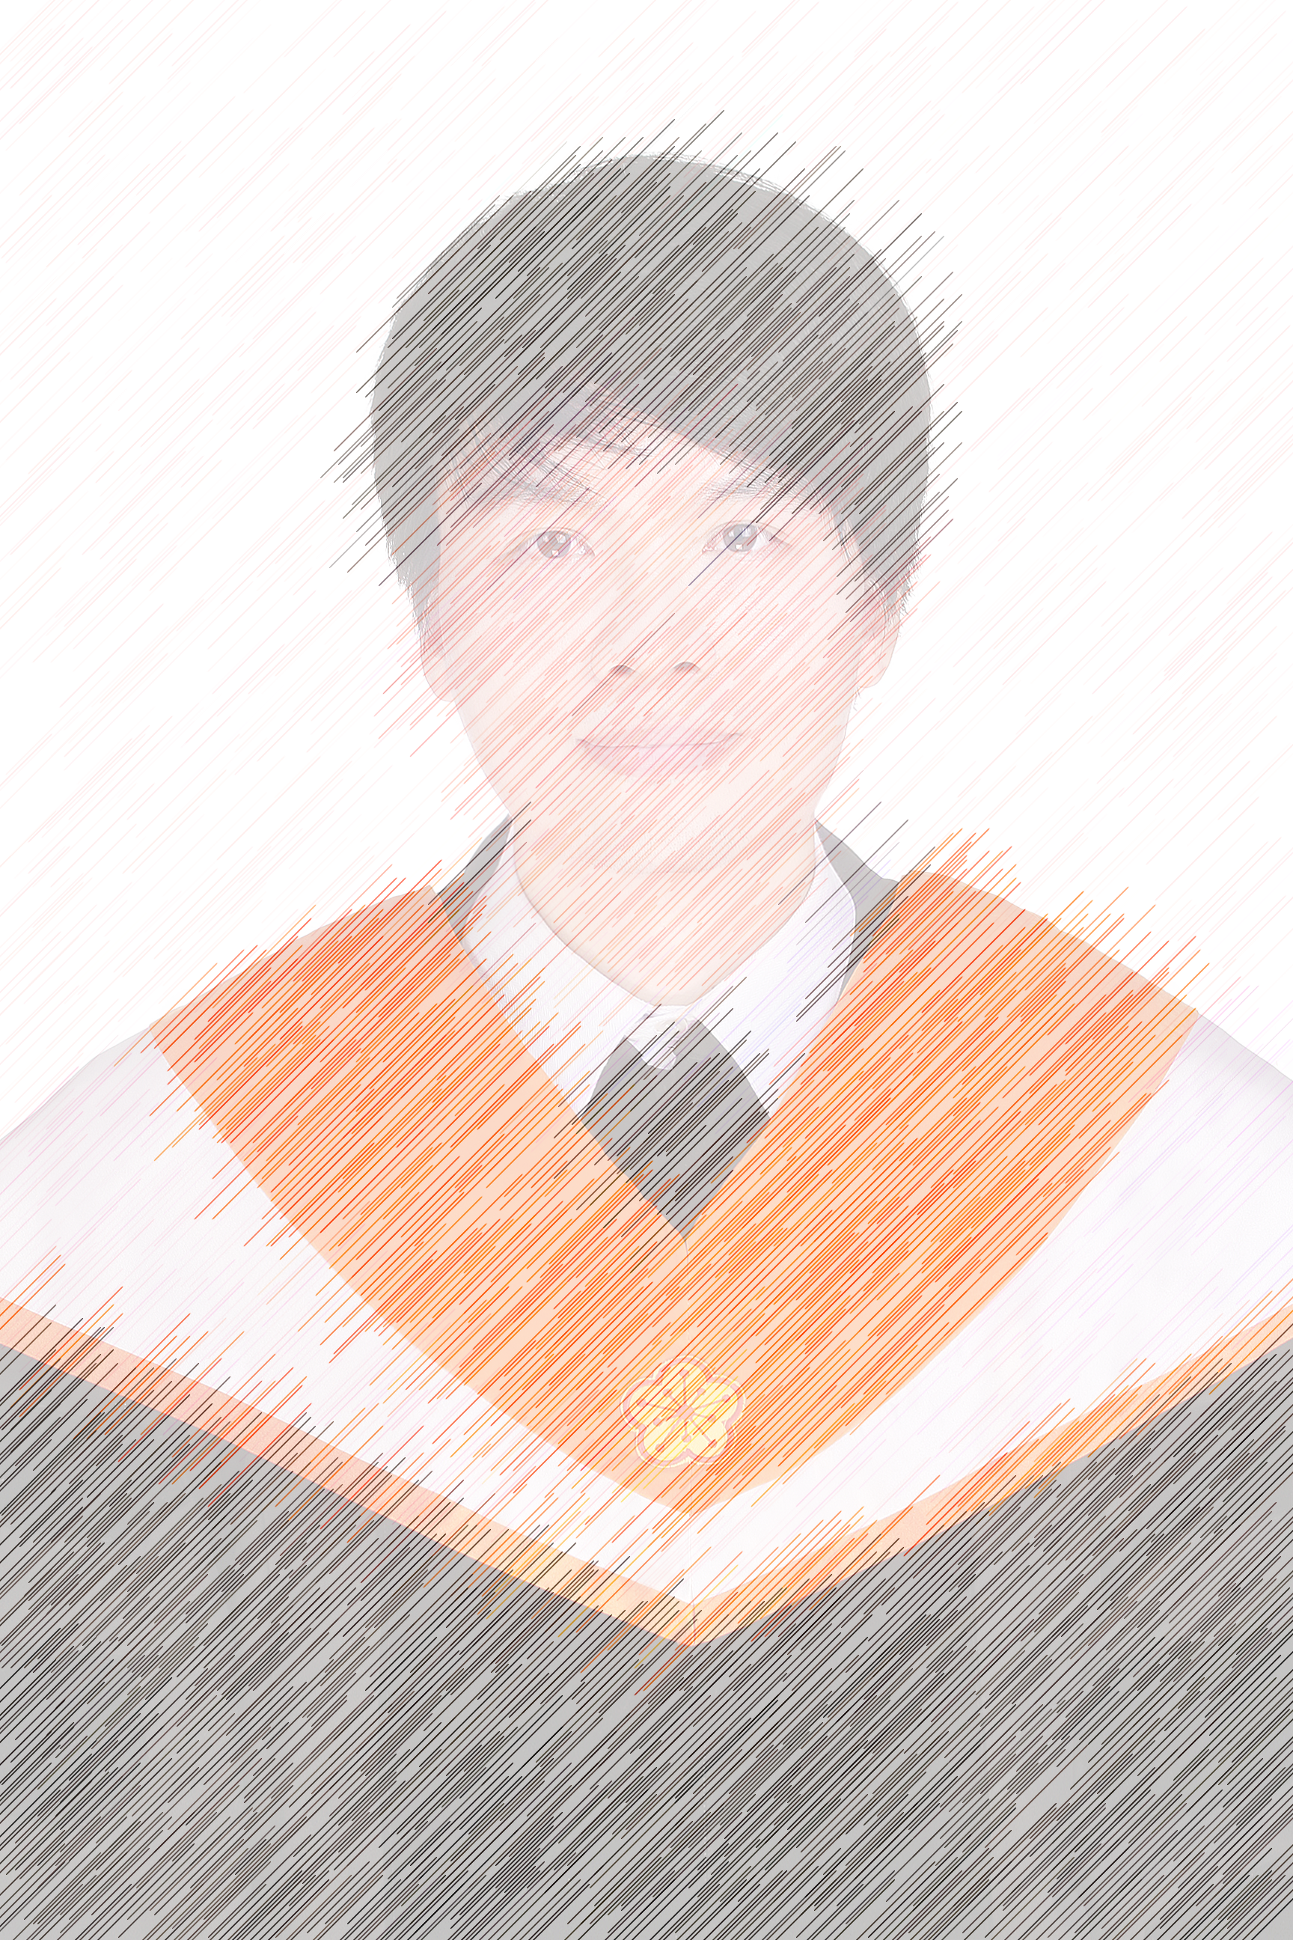
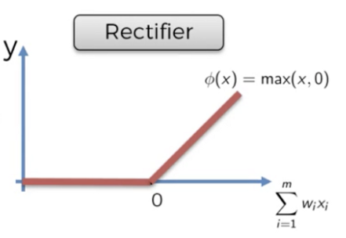
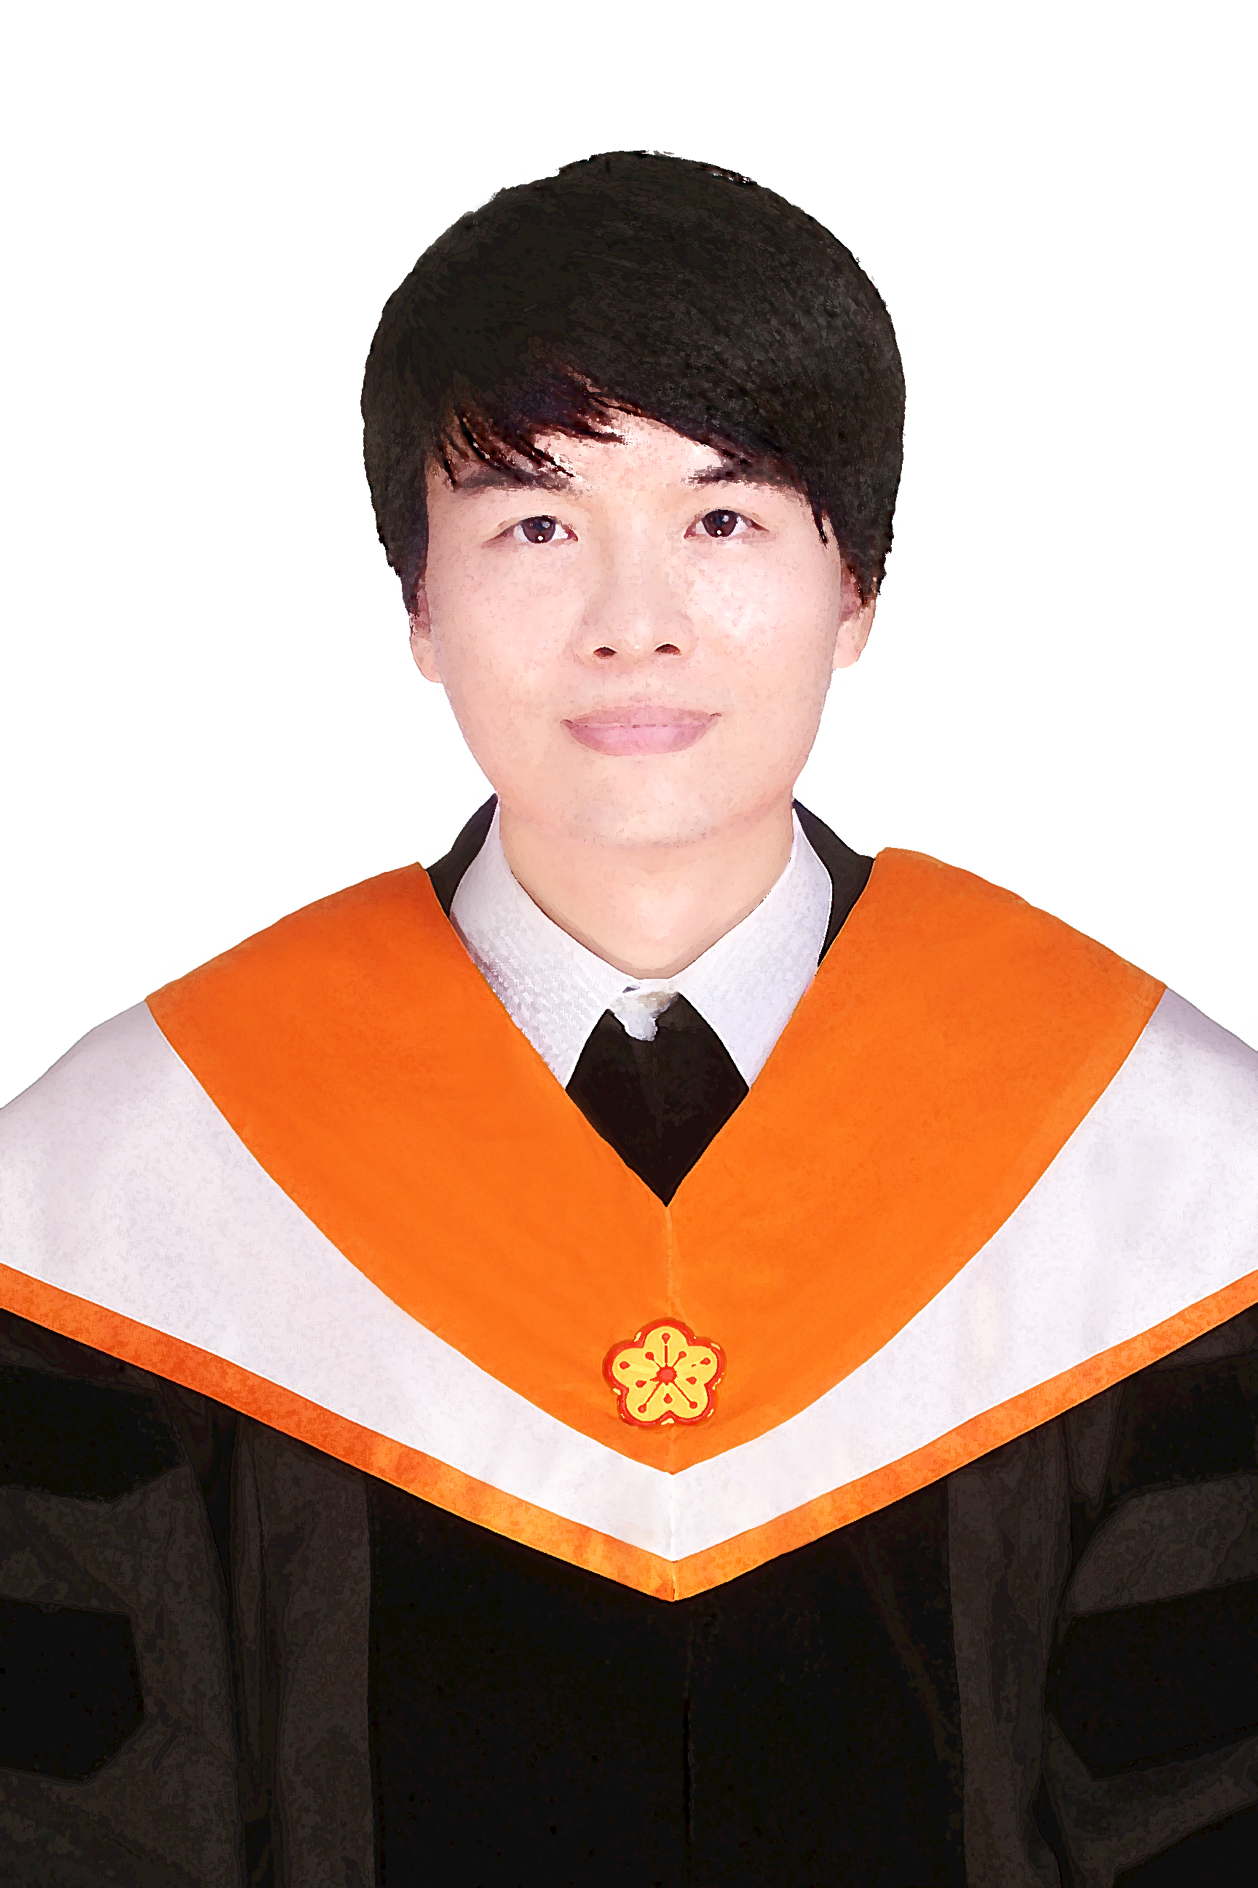
Depth
Output
14 x 7 x 8
1 | 0 | 1
0 | 1 | 0
1 | 0 | 1
Channel
Feature Map
0 | 0 | 1
0 | 0 | 0
1 | 0 | 0
2 | 0 | 2
0 | 1 | 0
2 | 0 | 2
1 | 0 | 0
0 | 0 | 0
0 | 0 | 1
16 x 9 x 3
Notes:
Channel跟聚幾個filter(kernel數)決定

Slide 25
CNN
3-dimension
1-dimension
ReLU
Input
Convolution
Pooling
Feature Extraction
Notes:
https://towardsdatascience.com/a-comprehensive-guide-to-convolutional-neural-networks-the-eli5-way-3bd2b1164a53

Slide 26
Flatten
Flatten
3-dimension
1-dimension
Input Layer
1
1 | 2
3 | 4
2
3
4
1 | 3
5 | 6
1
3
5
6
Channel

Slide 27
Padding
Zero padding
0
0
0
0
0
0
0
0
Keep the same image size
0
0
0
0
0
1
-2
-3
-2
-2
0
0
0
1
0
1
1
1
0
1
0
0
2
3
1
1
-1
0
0
-1
-1
-1
0
0
0
0
1
0
0
-2
-3
-1
-2
-1
-2
0
1
1
1
*
-1
-2
-4
-2
-1
1
0
0
0
0
0
1
0
0
-1
-1
-1
0
1
1
1
0
0
0
1
2
3
1
0
-1
0
0
0
0
0
0
0
-1
-2
-3
-2
-1
0
0
0
0
0
0
0
0
0
0
0
6 X 6 image

Slide 28
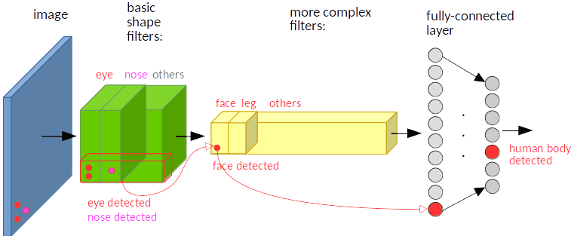
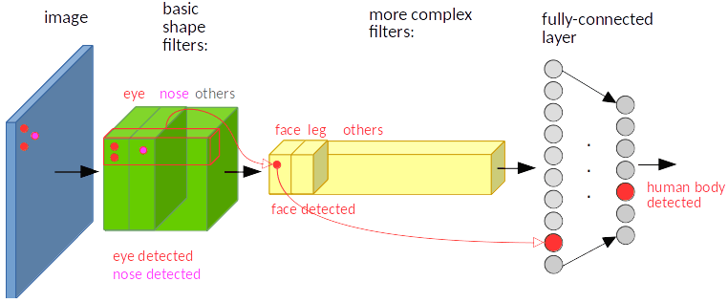
Invariance to Translating

Slide 29
CNN vs. DNN
The fundamental difference between a densely connected layer and a convolution layer:
Dense layers learn global patterns in their input feature space
Convolution layers learn local patterns
Notes:
P.122

Slide 30
CNN-Keras Example
Step 1:
# Import Keras libraries and packages
from keras.models import Sequential # Start a NN
from keras.layers import Conv2D # Convolution Operation
from keras.layers import MaxPooling2D # Pooling
from keras.layers import Flatten
from keras.layers import Dense # Fully Connected Networks
Input are 128 x 128 RGB images
There are 32 3x3 filters
Step 2:
# initializing CNN
model = Sequential()
model.add(Conv2D(32, 3, 3, input_shape = (128, 128, 3), activation = 'relu’))
model.add(MaxPooling2D(pool_size = (2, 2)))
The block size of max pooling is 2x2
1:white, 3:RGB

Slide 31
CNN-Keras Example
Step 3:
# Second convolutional layer
model.add(Conv2D(32, 3, 3, activation = 'relu')) model.add(MaxPooling2D(pool_size = (2, 2)))
Step 4:
# Flatten feature maps
model.add(Flatten())
If the total class number is 10
Step 5:
# Add fully connected layer
model.add(Dense(128, activation = 'relu’))
model.add(Dense(10, activation='softmax'))

Slide 32
Evolution of CNN Architectures
CNN started to get attention

Slide 33
Evolution of CNN Architectures
ILSVR: ImageNet Large Scale Visual Recognition Challenge
16.4
Error rate less than human’s recognition
7.3
6.7
8 layers
19 layers
22 layers
3.57
152 layers
ILSVRC’12
AlexNet
ILSVRC’14
VGG
ILSVRC’14
GoogleNet
ILSVRC’15
ResNet

Slide 34
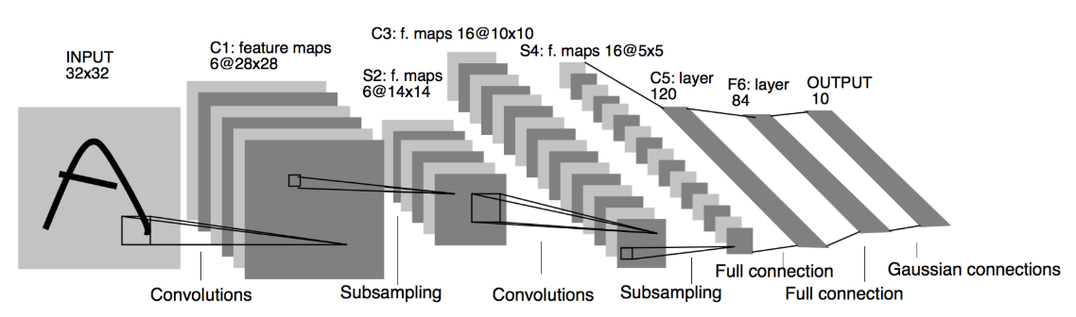
Classic CNN Architectures
LeNet-5 Architecture, 1998
# initialize the model
model = Sequential()
# first layer, convolution and pooling
model.add(Conv2D(input_shape=(32, 32, 1), kernel_size=(5, 5), filters=6, strides=(1,1), activation='tanh'))
model.add(AveragePooling2D(pool_size=(2, 2), strides=(2, 2)))
# second layer, convolution and pooling
model.add(Conv2D(kernel_size=(5, 5), filters=16, strides=(1,1), activation='tanh'))
model.add(AveragePooling2D(pool_size=(2, 2), strides=(2, 2)))
(horizontal, vertical)
2x2
2x2
2x2
2x2

Slide 35
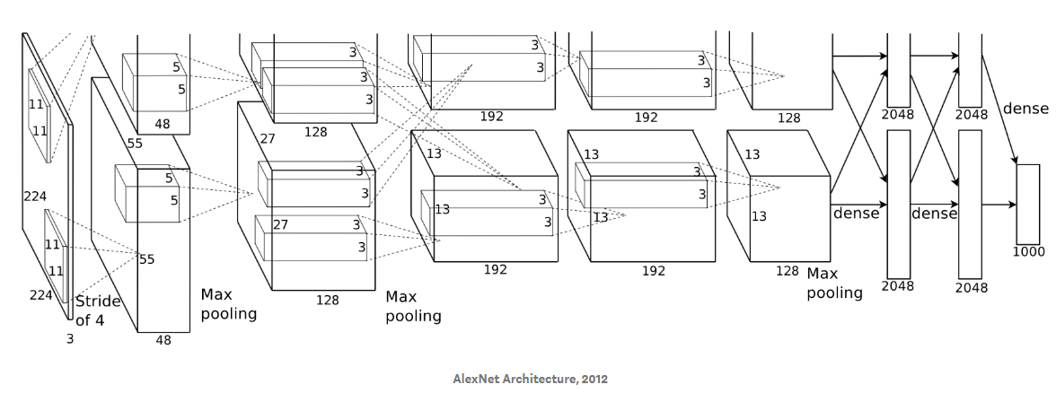
Classic CNN Architectures
Use ReLU and Dropout
AlexNet-5 Architecture, 2012
The architecture was divided into two parts because of memory limitation at that time
# initialize the model
model = Sequential()
#First Convolution and Pooling layer
model.add(Conv2D(96,(11,11),strides=(4,4),input_shape=(224,224,3),padding='valid',activation='relu'))
model.add(MaxPooling2D(pool_size=(3,3),strides=(2,2)))
#Second Convolution and Pooling layer
model.add(Conv2D(256,(5,5),strides=(1,1),padding='same',activation='relu'))
model.add(MaxPooling2D(pool_size=(3,3),strides=(2,2)))
#Three Convolution layer and Pooling Layer
model.add(Conv2D(384,(3,3),strides=(1,1),padding='same',activation='relu'))
model.add(Conv2D(384,(3,3),strides=(1,1),padding='same',activation='relu'))
model.add(Conv2D(256,(3,3),strides=(1,1),padding='same',activation='relu'))
model.add(MaxPooling2D(pool_size=(3,3),strides=(2,2)))

Slide 36
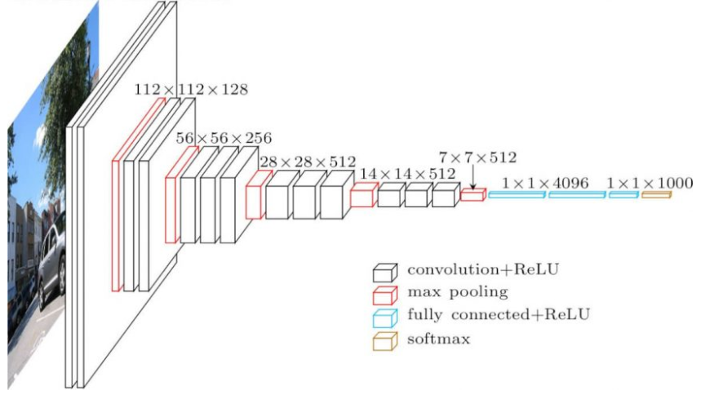
Classic CNN Architectures
VGG16 Architecture
# initialize the model
model = Sequential()
# VGG16
model.add(Conv2D(64,(3,3),strides=(1,1),input_shape=(224,224,3),padding='same',activation='relu'))
model.add(Conv2D(64,(3,3),strides=(1,1),padding='same',activation='relu'))
model.add(MaxPooling2D(pool_size=(2,2)))
model.add(Conv2D(128,(3,2),strides=(1,1),padding='same',activation='relu'))
model.add(Conv2D(128,(3,3),strides=(1,1),padding='same',activation='relu'))
model.add(MaxPooling2D(pool_size=(2,2)))
model.add(Conv2D(256,(3,3),strides=(1,1),padding='same',activation='relu'))
model.add(Conv2D(256,(3,3),strides=(1,1),padding='same',activation='relu'))
model.add(Conv2D(256,(3,3),strides=(1,1),padding='same',activation='relu'))
model.add(MaxPooling2D(pool_size=(2,2)))
model.add(Conv2D(512,(3,3),strides=(1,1),padding='same',activation='relu'))
model.add(Conv2D(512,(3,3),strides=(1,1),padding='same',activation='relu'))
model.add(Conv2D(512,(3,3),strides=(1,1),padding='same',activation='relu'))
model.add(MaxPooling2D(pool_size=(2,2)))
model.add(Conv2D(512,(3,3),strides=(1,1),padding='same',activation='relu'))
model.add(Conv2D(512,(3,3),strides=(1,1),padding='same',activation='relu'))
model.add(Conv2D(512,(3,3),strides=(1,1),padding='same',activation='relu'))
model.add(MaxPooling2D(pool_size=(2,2)))

Slide 37
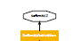
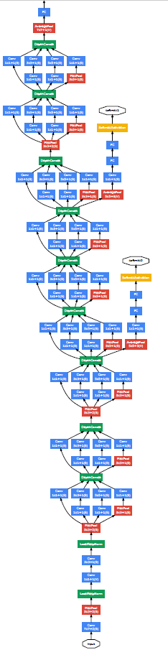
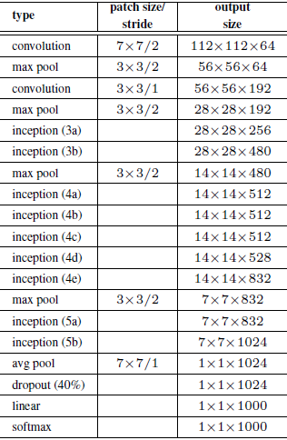
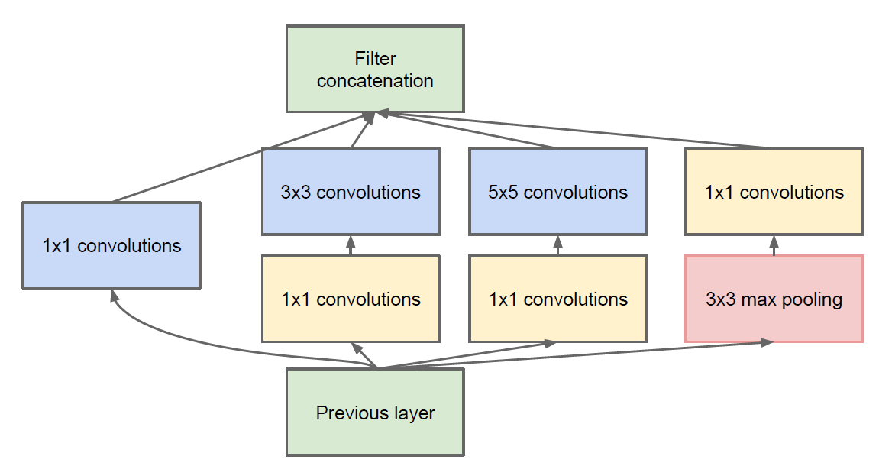
Classic CNN Architectures
Google net
Inception
Github code:
https://gist.github.com/joelouismarino/a2ede9ab3928f999575423b9887abd14

Slide 38
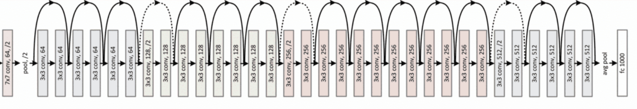
Classic CNN Architectures
34-layer residual
Image
Residual Network
https://arxiv.org/abs/1512.03385
https://github.com/broadinstitute/keras-resnet

Slide 39
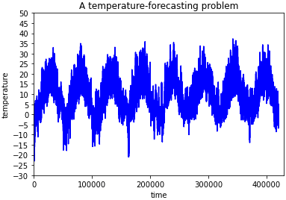
Time Series Problem
Output
t=0
.
.
.
t=400000
t=399999
Input

Slide 40
Recurrent Neural Network (RNN)
Assume: No bias
O = tanh(W_{t399999h399999}X_{t399999}+W_{h399998h399999}h₃₉₉₉₉₈)
O
O=X_{t400000}
h₀ = tanh(W_{t0h0}X_{t0})
h₁ = tanh(W_{t1h1}X_{t1}+W_{h0h1}h₀)
W_{h0h1}
W_{h1h2}
W_{h399998h399999}
h₀
h₁
h₃₉₉₉₉₉
W_{t0h0}
W_{t1h1}
W_{t399999h399999}
X_{t0}
X_{t1}
X_{t399999}

Slide 41
Recurrent Neural Network (RNN)
O
O
h_{t}
x_{t}
X_{t}

Slide 42
Different types of RNN
many to one
one to many
many to many
many to many
Sentiment analysis where a given sentence is classified as expressing positive or negative sentiment
Image captioning takes an image and outputs a sentence of words
Machine Translation: an RNN reads a sentence in English and then outputs a sentence in French
Video classification where we wish to label each frame of the video

Slide 43
Recurrent Neural Network
Advantages:
Each sample can be assumed to be dependent on previous ones for sequence of data
Even used with convolutional layers to extend the effective pixel neighborhood.
Disadvantages:
Gradient vanishing and exploding problems
Training an RNN is a very difficult task
Cannot process very long sequences if using tanh or relu as an activation function.
Notes:
https://medium.com/@purnasaigudikandula/recurrent-neural-networks-and-lstm-explained-7f51c7f6bbb9?fbclid=IwAR1IWaesvLofzWS5o0REhPVDWJwocpd7Hmzr_cIOSVHo5EqgjsuCAqj-5CY

Slide 44
Recurrent Neural Network
P(Cat) = 0.33
P(Dog) = 0.33
P(Hamster) = 0.33
Chunk of irrelevant text
RNN
RNN
RNN
“I have a dog named Cliff.”
“I enjoy all kinds of sports.”
“However, Cliff, my pet ___”
Notes:
https://blog.floydhub.com/long-short-term-memory-from-zero-to-hero-with-pytorch/?fbclid=IwAR2NVuJSkMxkqnQHprx6K0l_cNTgJiSWmuLMGDxygupJrhFmhvcPXqq6xRQ

Slide 45
Long Short-Term Memory
P(Cat) = 0.05
P(Dog) = 0.85
P(Hamster) = 0.1
Long-term Memory:
Pet - ”dog”
Chunk of irrelevant text
LSTM
LSTM
LSTM
“I have a dog named Cliff.”
“I enjoy all kinds of sports.”
“However, Cliff, my pet ___”
Notes:
https://blog.floydhub.com/long-short-term-memory-from-zero-to-hero-with-pytorch/?fbclid=IwAR2NVuJSkMxkqnQHprx6K0l_cNTgJiSWmuLMGDxygupJrhFmhvcPXqq6xRQ

Slide 46











LSTM Architecture
h_{t-1}
h_{t}
h_{t+1}
$$×$$
$$+$$
$$×$$
$$+$$
$$×$$
$$+$$
tanh
tanh
tanh
$$×$$
$$×$$
$$×$$
𝜎
$$×$$
𝜎
$$×$$
𝜎
$$×$$
𝜎
tanh
𝜎
tanh
𝜎
tanh
𝜎
𝜎
𝜎
x_{t-1}
x_{t}
x_{t+1}
Notes:
https://blog.floydhub.com/long-short-term-memory-from-zero-to-hero-with-pytorch/?fbclid=IwAR2NVuJSkMxkqnQHprx6K0l_cNTgJiSWmuLMGDxygupJrhFmhvcPXqq6xRQ

Slide 47
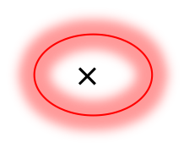


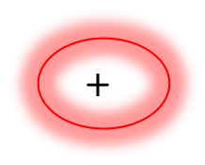
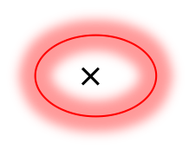
LSTM Architecture
0.5
0.5
0.5
0.1
0.3
0.5
Plus junction: element-by-element addition
Signal
Gating
0.5×0.6
0.5×0.8
0.5×1.0
0.3
0.4
0.5
0.1+0.6
0.3+0.4
0.5+0.2
0.7
0.7
0.7
×
$$+$$
On/Off
gating
0.6
0.8
1.0
0.6
0.4
0.2
Output
Cell State/Long-term Memory
$$×$$
$$+$$
New Cell State
tanh
$$×$$
Forget Gate
Sigmoid
$$×$$
New Hidden State
Sigmoid
tanh
Hidden State/Short-term Memory
Sigmoid
Output Gate
Input
Input Gate
Forget gate: 決定丟棄資料
Red line: 更新細胞狀態
Input gate: 確定更新的資料
Output gate: 輸出資料
Sigmoid輸出0跟1當作控制閥
Notes:
https://blog.floydhub.com/long-short-term-memory-from-zero-to-hero-with-pytorch/?fbclid=IwAR2NVuJSkMxkqnQHprx6K0l_cNTgJiSWmuLMGDxygupJrhFmhvcPXqq6xRQ
https://brohrer.mcknote.com/zh-Hant/how_machine_learning_works/how_rnns_lstm_work.html

Slide 48


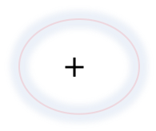
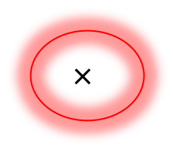
Input Gate
Output
Cell State/Long-term Memory
$$×$$
$$+$$
New Cell State
tanh
$$×$$
Sigmoid
$$×$$
New Hidden State
Sigmoid
tanh
Hidden State/Short-term Memory
Sigmoid
Input
Decide what new information will be stored in the long-term memory
Notes:
https://blog.floydhub.com/long-short-term-memory-from-zero-to-hero-with-pytorch/?fbclid=IwAR2NVuJSkMxkqnQHprx6K0l_cNTgJiSWmuLMGDxygupJrhFmhvcPXqq6xRQ
https://brohrer.mcknote.com/zh-Hant/how_machine_learning_works/how_rnns_lstm_work.html

Slide 49
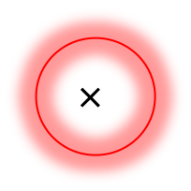

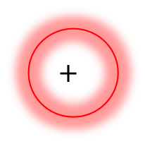

Forget Gate
Decide which information from the long-term memory should be kept or discarded
Output
Cell State/Long-term Memory
$$×$$
$$+$$
New Cell State
tanh
$$×$$
Sigmoid
$$×$$
New Hidden State
Sigmoid
tanh
Hidden State/Short-term Memory
Sigmoid
Input
Notes:
https://blog.floydhub.com/long-short-term-memory-from-zero-to-hero-with-pytorch/?fbclid=IwAR2NVuJSkMxkqnQHprx6K0l_cNTgJiSWmuLMGDxygupJrhFmhvcPXqq6xRQ
https://www.cnblogs.com/wangduo/p/6773601.html

Slide 50
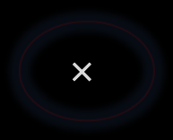
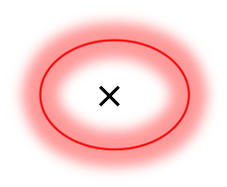
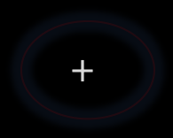
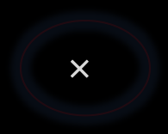
Output Gate
Output
Cell State/Long-term Memory
$$×$$
$$+$$
New Cell State
tanh
$$×$$
Sigmoid
$$×$$
New Hidden State
Sigmoid
tanh
Hidden State/Short-term Memory
Sigmoid
Input
Notes:
https://blog.floydhub.com/long-short-term-memory-from-zero-to-hero-with-pytorch/?fbclid=IwAR2NVuJSkMxkqnQHprx6K0l_cNTgJiSWmuLMGDxygupJrhFmhvcPXqq6xRQ
https://brohrer.mcknote.com/zh-Hant/how_machine_learning_works/how_rnns_lstm_work.html

Slide 51
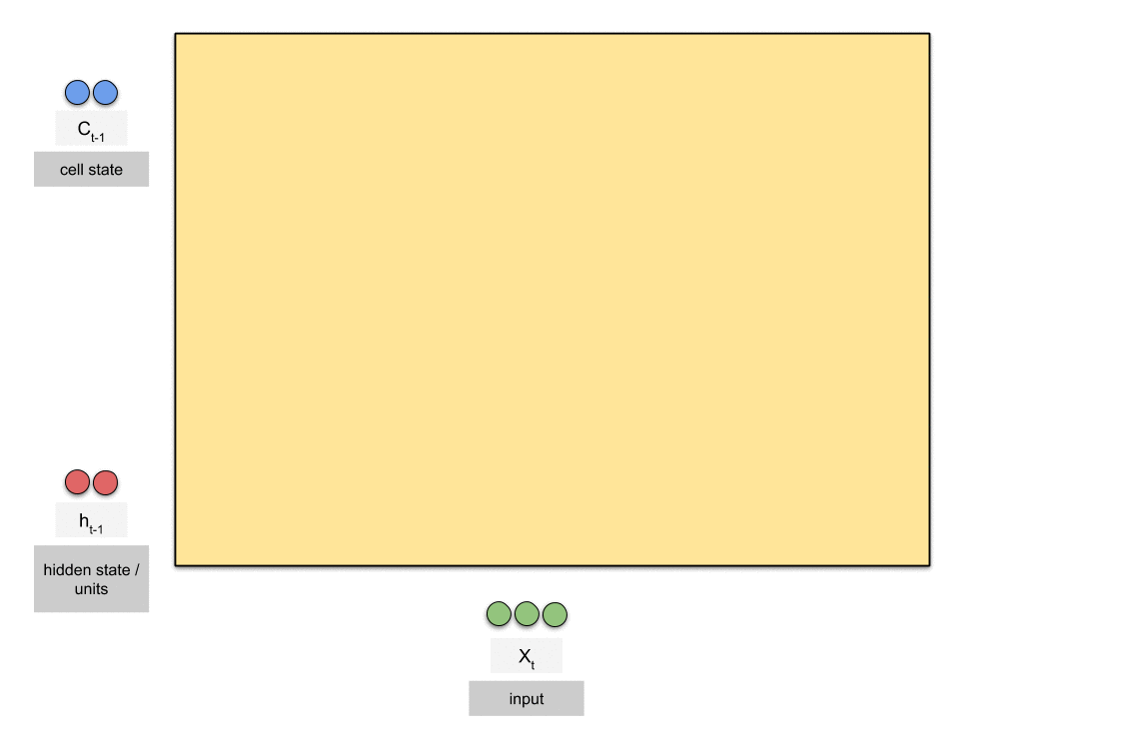
LSTM with Gates
Notes:
https://medium.com/@purnasaigudikandula/recurrent-neural-networks-and-lstm-explained-7f51c7f6bbb9

Slide 52
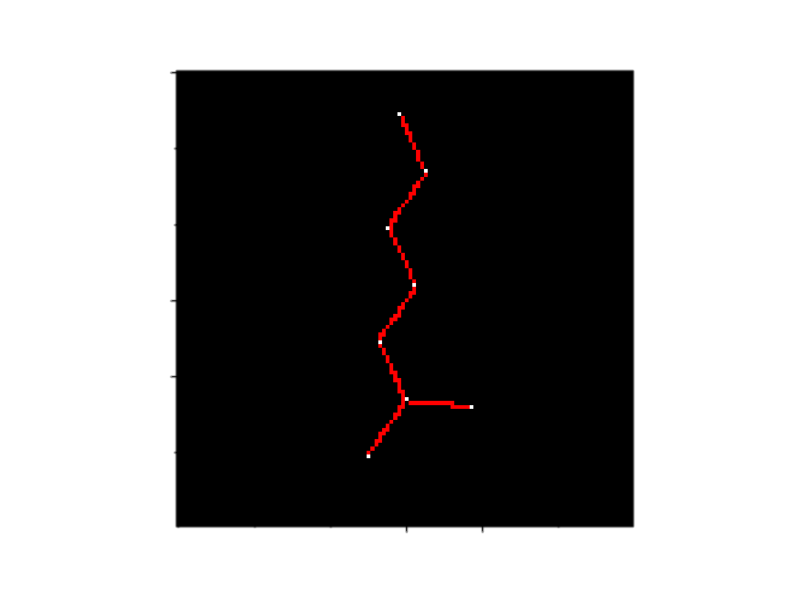
CNN RNN
Convolution Neural Network
Input
Convolution
Pooling
Flatten
Output
深度學習演算法可以直接從影像、文字、與聲音中進行特徵、表現、以及任務的學習，來降低以人工進行特徵選取的需求。
Feature extract from images
Classification or Regression
Recurrent Neural Network
C[C@H]([C@@H](C)Cl)Cl
C(C=CBr)N
CCC(CO)Br
CCCOCCP
C(C(F)(F)F)F
[2H]C([2H])C(C)(C)Cl
Recurrent unit
History/State
Input
Output
Find the relationships between these characters
Classification or Regression

